Slide 1

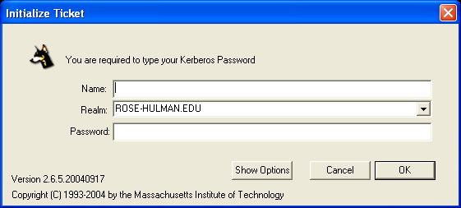
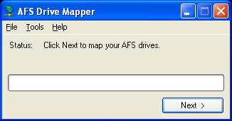
Accessing AFS
AFS is your network storage space
  You have 100MB of space for your public directory and 100MB for the rest of your AFS folders
It is accessible through special network drives mapped by the AFS Drive Mapper
Run the AFS Drive Mapper from your desktop now
It will start the OpenAFS service, then automatically open Leash
Log on to Leash using your Kerberos (Rose) username and password when prompted

Slide 2
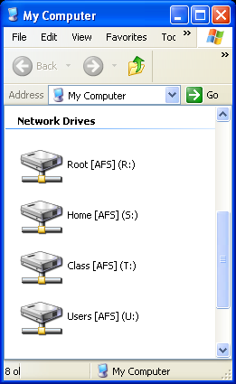
AFS Drives
Open My Computer
You will notice 4 Network Drives:
  Root [AFS] (R:)
    The top of the AFS directory
  Home [AFS] (S:)
    Personal files to Private
    Files you wish to share to Public
    OldFiles contains a single day backup
  Class [AFS] (T:)
    Academic directories traditionally contain files for the various departments and courses
    Catapult:
      T:\csse\catapult\Summer2007
      On the web, this is http://www.rose-hulman.edu/class/csse/catapult/Summer2007/
  Users [AFS] (U:)
    You can find other users’ publicly shared files in these directories
Slides courtesy of Rose-Hulman freshmen laptop orientation sponsored by IAIT

